Slide 1


الاعتداء اللفظى
Cyberbullying Detection
By:
John Hani
Mohamed Nashaat
Mostafa Ahmed
Zeyad Emad (Team Leader)
Under supervision of :
Dr. Ammar Mohamed
Dr. Eslam Amer
Eng. Menna Gamil
Date:22/6/2019

Slide 2

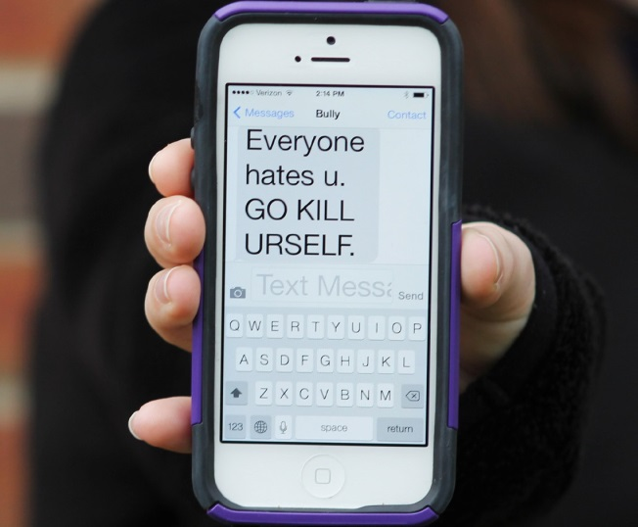
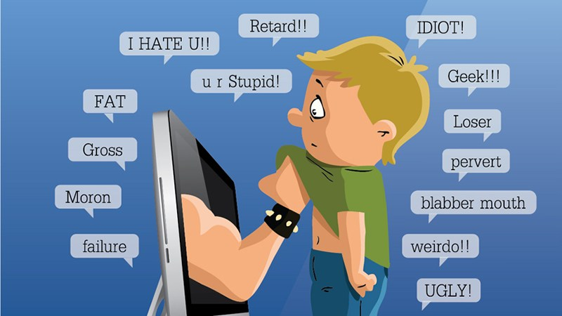
Introduction
Cyberbullying (الاعتداء اللفظى) over social media is dangerous, almost 1 out of 3 teens is exposed to cyber threats[1].
Threat methods
Physical
Verbal
Social
Cyber
[1] National Crime Prevention Council, “Cyberbullying”
i-SAFE Inc., “Cyber Bullying: Statistics and Tips”
Richard Webster, Harford County Examiner, “From cyber bullying to sexting: What on your kids cell?”

Slide 3
Approaches of differentiating Cyberbullying.
Dictionary
Abbreviations
Provide sufficient dataset
Shortened form of a word or phrase. Ex. Brb stands for be right back.
Homographs
Words that are spelled the same but have different meanings. Ex. Play & play

Slide 4
Market Motivation
Creating a Safe Social Media environment for teenagers to communicate.
Allowing parents to set controls on their children’s internet use ( Parental Control ).

Slide 5
Problem Statement
Detection of false positive cyberbullied cases.
Real-time portable application.
Increase accuracy

Slide 6
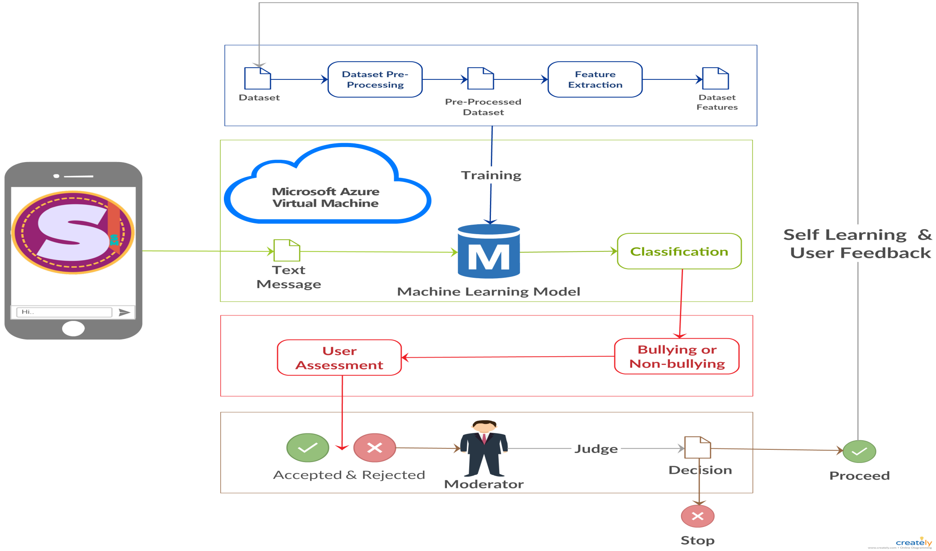
Proposed System diagram

Slide 7







Technologies

Slide 8
Experiment
Compare Between users and our classifier in the detection of cyberbullying by giving ten sentences with cyberbullying and non cyberbullying and make them choose which is which.
Define the strength of our classifier against Humans.

Slide 9
Experiment Results (Graph)
Our classifier scored higher than users in detecting cyberbullying instances.

Slide 10
Contribution
Developed a portable chatting application.
Achieved 92.8% accuracy with Feed-Forward Neural Network.
Introduced Self-Learning to refine the dataset and reduce the false positive instances.

Slide 11
Achievements
Published a paper in (IJACSA) International Journal of Advanced Computer Science and Applications,
Vol. 10, No. 5, 2019
https://thesai.org/Publications/ViewIssue?volume=10&issue=5&code=IJACSA

Slide 12
Demo

Slide 13
Any Questions?

Slide 14
Pre-Processing
This message is a grea test \n message
Stemming
[Thi , message, is , a , grea , test , \n , message]
Lemmatization
[Thi , message, is , a , grea , test , \n , message]
Auto Correct *BING API*
[This ,message ,is , a , great , test , \n , message]
Remove Encoding & Lowering text
[this ,message ,is , a , test , message]
Notes:
14

Slide 15
Experiment 2/3
In experiment 2 our goal was to compare the results of our proposed system that used SVM and FF Neural Network for classification with the work of [4]. In this work, they used logistic regression and SVM for classification and used the same data.
Exploring our work and finding the optimal solution.
Exploring the importance of Sentiment analysis
[4] V. S. Chavan and S. Shylaja, “Machine learning approach for detection of cyberaggressive
comments by peers on social media network,” in Advances in computing,
communications and informatics (ICACCI), 2015 International Conference on. IEEE,
2015, pp. 2354–2358.

Slide 16
Processing
Support Vector Machine
Feed Forward Neural Network
Three layers: Input, hidden, output layer. Input layer consists of 128 nodes. Hidden layer contains 64 neurons.
Linear Kernel

Slide 17
Experiment 2/3 Results
It is found that our proposed NN model outperforms all other classifiers and is ranked as the best results in terms of average accuracy and F-Score achieving accuracy 91.76% and f-score 91.9%.

Slide 18
Experiment 1/3
In experiment 1 we have compared the accuracy , precision and recall of all the classifiers that are mentioned in the related work of cyberbullying detection to have the highest accuracy and the least false positive.
•Exploring different classifiers and finding the optimal solution.
•Feed-forward NN has high accuracy and the least false positive instances.

Slide 19
Feature extraction
TF-IDF
this , message ,is , a , test , message
0.167, 0.3 , 0.167 , 0.167 , 0.167
Sentiment Features
this ,message ,is , a , test , message
0.2, The polarity is neutral

Slide 20
Experiment 1/3 Results (Graph)
Dataset was balanced therefore accuracy reading was enough

Slide 21
Questions related to (Experts and Machines Against Bullies: A Hybrid
Approach to Detect Cyberbullies)
Multi-Criteria Evaluation Systems (MCES): *made by 12 experts*
Four-point scale ‘Unlikely’, ‘Less likely’, ‘Likely’ and ‘Very likely’ corresponding to
values 0.125, 0.375, 0.625 and 0.875 respectively. The 'I don't know' option was also
available.
The importance was indicated on a four-point scale of 1: not informative, 2: partially informative, 3: informative and 4: very informative.
The ratio of capital letters in a comment.
The number of emoticons. The occurrence of a second person pronoun followed by a profane word in profanity. The term frequency–inverse document frequency (Tf-Idf).
H1: Using the outcome of the MCES as an extra feature for training the machine learning models. Results, features’ categories and profanity – misspelling .
H2: Using the results of the machine learning model as a new criterion for the expert system by assigning equal weights.
(Decision Tree bad, SVM better, Naïve Bayes best)

Slide 22
Questions related to (Machine Learning Approach for Detection of Cyber-Aggressive Comments by Peers on Social Media Network)
What is N-grams?
These are used for dividing text and words into n chunks known as N-grams. Example: “You are funny” its unigram will be “you”,”are”,”funny”.They used 2, 3, 4 and 5 N-grams for the building feature vector.
What is TF-IDF Score?
It is a way to evaluate the importance of words in a document based on how frequently they appear across various documents.
What is Logistic Regression?
This algorithms provides probabilistic approach to data. The outcome are probabilities modeled as a function of predicted variables, using a logistic function given below. Also it’s a binary classifier. p=1/(1+e-)

Slide 23
Related Work Cont.
Machine Learning Approach for Detection of Cyber-Aggressive
Comments by Peers on Social Media Network
Contribution
Pre-Processing: Normalization like: removing unwanted strings and correcting words.
Features: N-gram , TF-IDF , occurrence of pronouns , Skip-gram
Classifiers: Support Vector Machine (SVM) , Logistic Regression
Results
70.0% Precision and 77.65% Acc. using SVM
64.0% Precision and 73.76% Acc. using logistic regression
Challenges
Accuracy
False Positive Rates

Slide 24
Related Work
Automatic Detection of Cyberbullying on Social Networks
based on Bullying Features
Contribution
Pre-Processing: a twitter-specialized tokenizer .
Features: Bag-of-Words , Latent Semantic Features
Classifiers: Support Vector Machine (SVM)
Results
They Scored 78% with F1-Score using EBOW.
Challenges
Accuracy
Portability
False positive Rate.

Slide 25
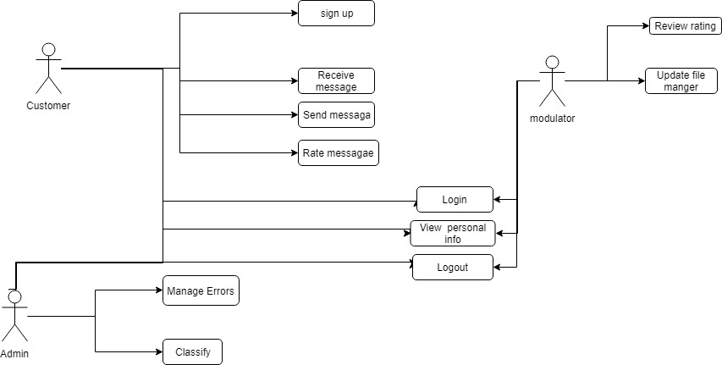
USE Case

Slide 26



Non Functional Requirements
Security
Maintainability
Portability
Have Encryption and Decryption
Self Learning
Both Desktop and Android

Slide 27
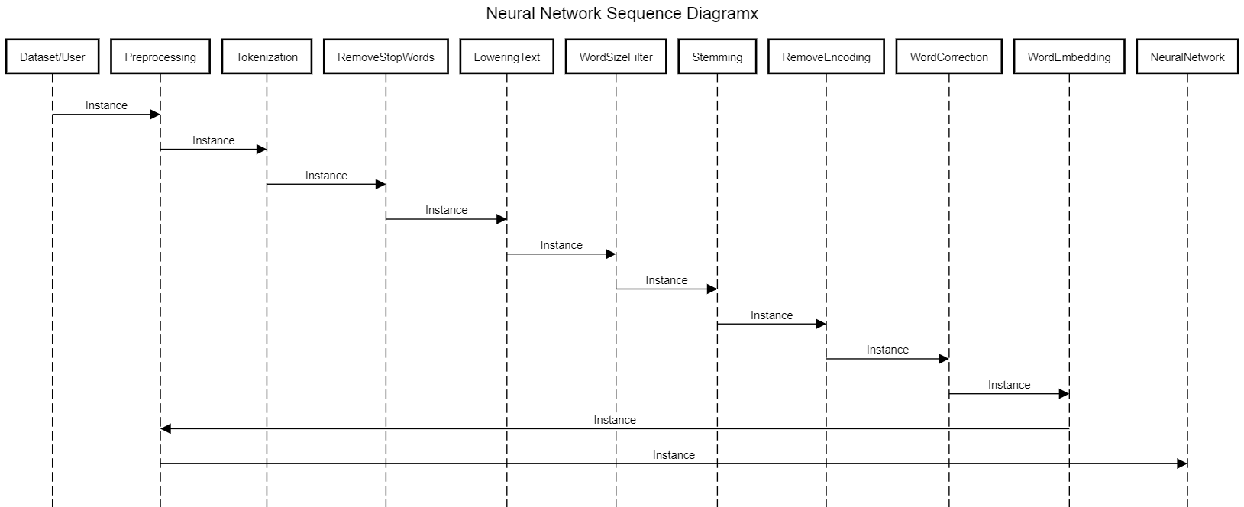
Sequence diagram

Slide 28
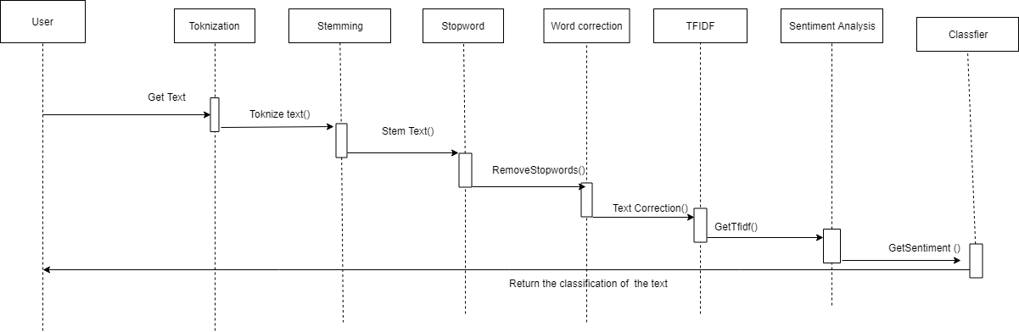
Sequence diagram
Lowering
Text
LoweringText()

Slide 29
Non Functional Requirements
Security
Maintainability
Portability
Have Encryption and Decryption
Self Learning
Both Desktop and Android

Slide 30
Related Work
Experts and Machines Against Bullies: A Hybrid Approach
to Detect Cyberbullies
Contribution
They used three machine learning methods: a Naive Bayes classiﬁer, decision trees and Support Vector Machines (SVM) with a linear kernel
Results
Naive Bayes scored the highest out of the three with 66%.
Challenges
Accuracy
Portability
Scalability

Slide 31
What we have used
TFIDF
Construct weight Vector for the sentence based of the fitted vocabulary from the dataset
Sentiment analysis
Calculate the Total Polarity of the Sentence
SVM
Used to classify the messages received from the Social Media receives the vector Resulted from TF-IDF and the polarities from the Sentiment analysis.
Ref:
Cyberbullying System Detection and Analysis
Experts and Machines Against Bullies A Hybrid Approach to Detect Cyberbullies
Cyberbullying Detection using Time Series Modeling
Machine Learning Approach for Detection of Cyber-Aggressive Comments by Peers on Social Media Network

Slide 32
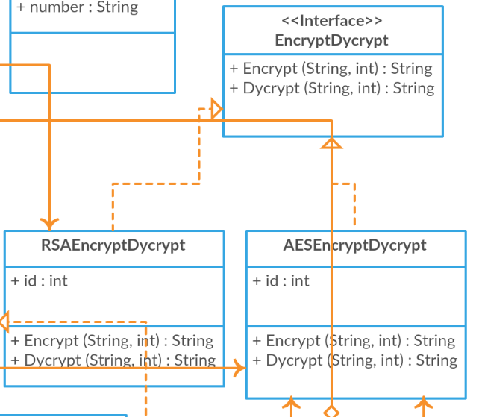
Strategy Design Pattern

Slide 33
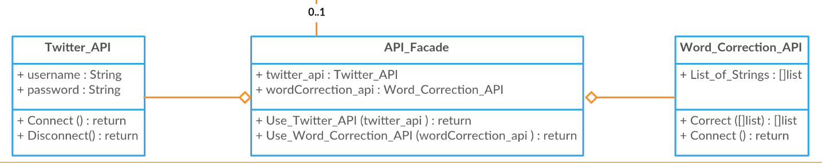
Facade Design Pattern

Slide 34
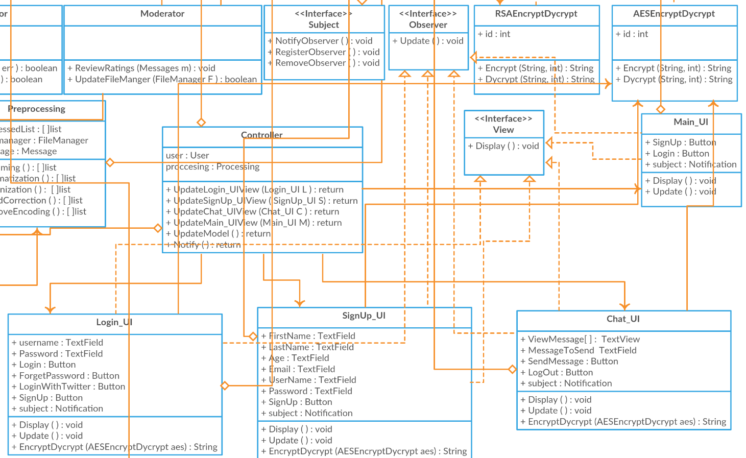
Observer Design Pattern

Slide 35
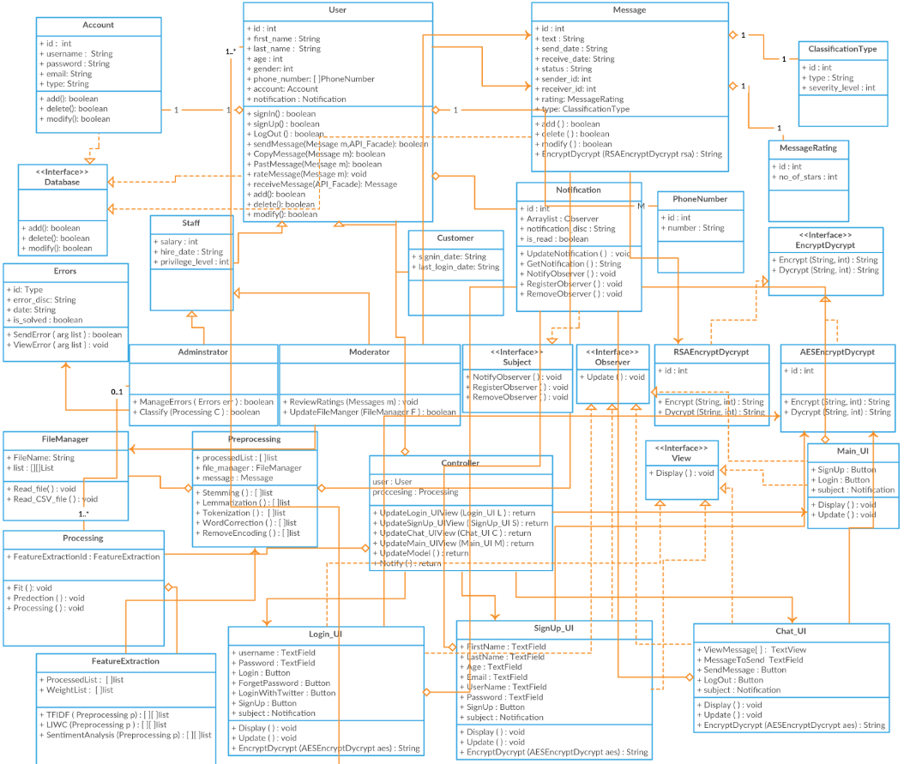
MVC Design Pattern

Slide 36
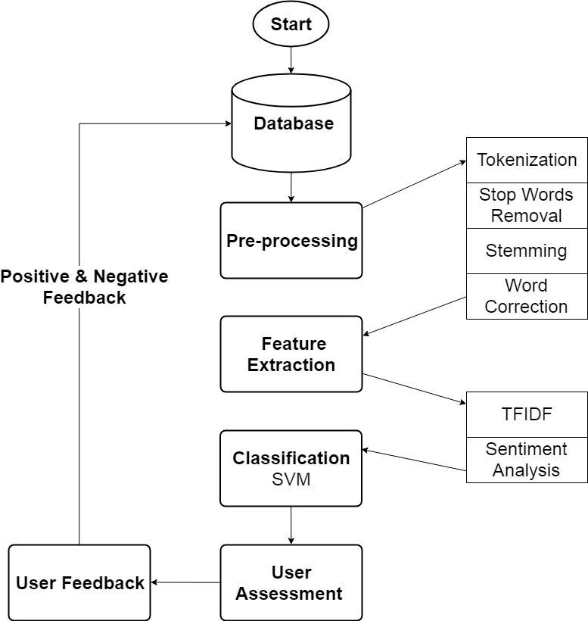
Activity diagram

Slide 37
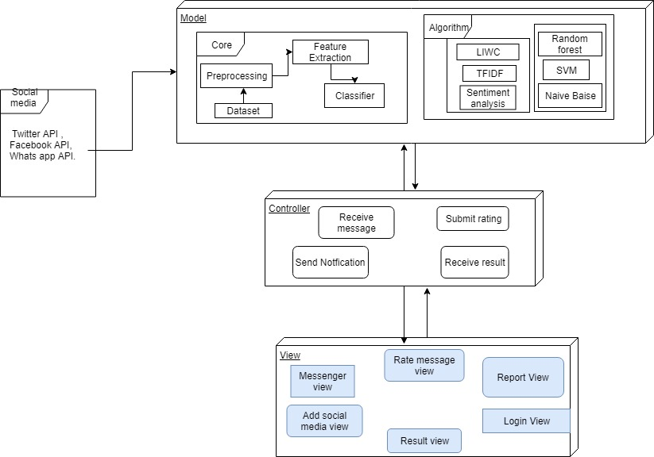
System Architecture
Feature
Extraction
Classifiers

Slide 38
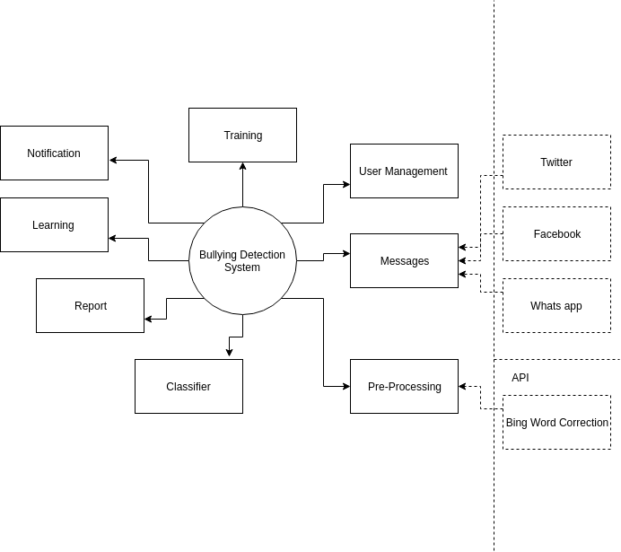
Context Diagram

Slide 39
Questions related to (A Pattern-Based Approach for Sarcasm Detection on Twitter)
What is F1 score?
F1=2*(precision*recall/precision+recall)
What is Accuracy?
It represents the overall correctness of classification.
=((true postives + false negatives)/sum of samples)
What is Precision?
It represents the fraction of retrieved objects(eg: sarcastic tweets) that are relevant.
=(True postives/retrieved items)
Tools used in NLP:
Apache OpenNLP
Gate Twitter part- of-speech tagger

Slide 40
Question Related to Pre-Processing
Stemming: Used NLTK Library
Limitization: Used NLTK Library
Word Correction: Used Bing Auto-Correct Library
Tokenization
Lowering Text
Remove Encoding: By Defining the Ascii of the character and the Non (“UTF-8”) Characters which has Ascii Number more than 128 +

Slide 41
Question Related to Processing
Train the Classifiers with different n-cross validation

